Slide 1

Submitted From :
Maria Akther Rimi
ID : 213902098
Ahashan Habib
ID : 222002008
Section : 223 D_3
Course Code : CSE 211
Title : Computer Architecture Paper .
Submitted To :
Jarin Tasnim Tonvi
Lecturer,
Department of CSE, GUB.

Slide 2

Teaching computer architecture by designing and simulating processors from their bits and bytes.
TOPIC
Table Of Contents
Introduction
04
Motivation
05
The Processor (CPU) Design
06
The Simulator
07
Results
08
Conclusion & Future Work
09
References
10

Slide 3

Let’s Explain
Step 6
Step 2
Step 5
Step 4
Step 3
Step 1

Slide 4
Introduction
In a technological era, understanding computer hardware is crucial. Teaching Comp-Arch faces challenges, but hands-on assignments can enhance student engagement and comprehension. This study introduces innovative assignments and assesses their impact, offering a practical solution for theoretical subjects.
Step 6
Step 4
Step 2
Step 5
Step 3
Step 1

Slide 5
Motivation
The CPU designs, MuSe and DoMe, were meticulously crafted with considerations for educational objectives and performance trade-offs. MuSe emphasizes simplicity akin to MIPS, while DoMe extends beyond with additional instructions. Both designs feature simulators and HDL implementations, enriching understanding and hands-on experience in computer architecture.
Step 6
Step 2
Step 5
Step 4
Step 3
Step 1

Slide 6
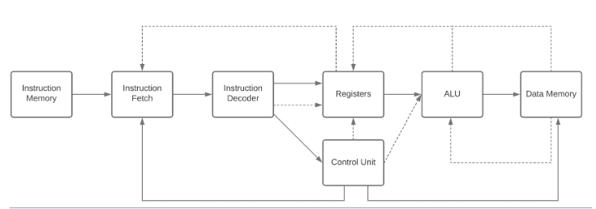
The Processor (CPU) Design
Step 6
Step 2
Step 5
Step 4
Step 3
Step 1
Figure 1: The Processor (CPU) Design.

Slide 7
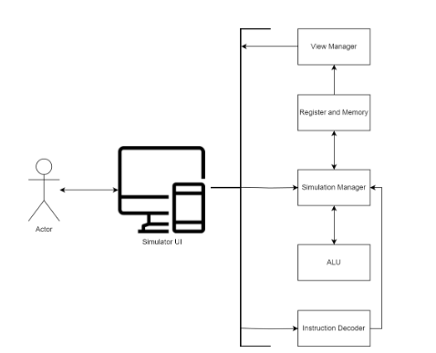
The Simulator
The MuSe architecture utilizes Java with JavaFX for its simulator, featuring clear memory and register visualization. In contrast, the DoMe architecture, using Python and PyQt5, emphasizes dynamic memory and stack representation.
Step 6
Step 2
Step 5
Step 4
Step 3
Step 1
Figure 2: The Simulator.

Slide 8
Results
A questionnaire, utilizing Likert scales, assessed students’ perceptions pre/post Computer Architecture course. Results showed significant improvements in hardware design knowledge and self-learning ability. Interest in low-level systems moderately increased. Some aspects like group work received mixed responses. A follow-up meeting highlighted benefits like enhanced understanding through discussions and guidance from supervisors, despite COVID-19 constraints impacting physical implementation.
Step 6
Step 5
Step 2
Step 4
Step 3
Step 1

Slide 9
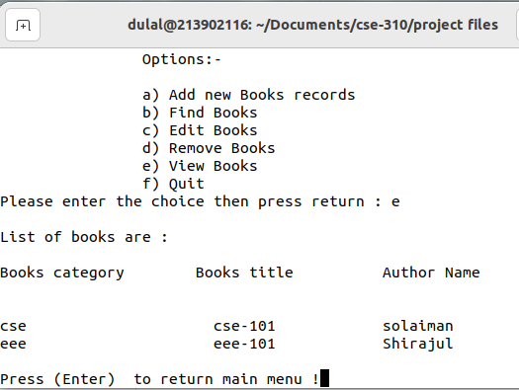
Conclusion & Future Work
This study explores a hands-on, team-oriented approach to motivate undergraduates in Comp-Arch, focusing on 16-bit processor design. It suggests integrating this project into courses and improving tools. Future research could optimize workload, explore alternate content coverage methods, and incorporate FPGA-based implementations to enhance understanding of embedded systems.
Step 6
Step 2
Step 5
Step 4
Step 3
Step 1
Figure 3.6: View-Books.

Slide 10
References
Araujo MRD, Padua FLC, Andrade FV, Correa-Junior FL. 2014. MIPS X-ray: a MARS simulator plug-in for teaching computer architecture. International Journal of Recent Contributions from Engineering, Science & IT (iJES) 2(2):36–42 DOI 10.3991/ijes.v2i2.3527.
Brox M, Gersnoviez A, Montijano MA, Herruzo E, Moreno CD. 2018. SICOME 2.0: a teaching simulator for computer architecture. In: 2018 XIII Technologies Applied to Electronics Teaching Conference (TAEE). Piscataway: IEEE, 1–7.
Dogan M. 2023. Dome risc16 verilog codes DOI 10.5281/zenodo.10204805.
Dogramaci S, Cataltas M. 2023a. Muse processor simulator codes
DOI 10.5281/zenodo.10204841.
5. Dogramaci S, Cataltas M. 2023b. Muse processor verilog codes
DOI 10.5281/zenodo.10204853.
6. Hennessy JL, Patterson DA. 2017. Computer architecture: a quantitative approach. Amsterdam:Elsevier

Slide 11
Thank You
Keep Learning, Keep Grinding

